Slide 1
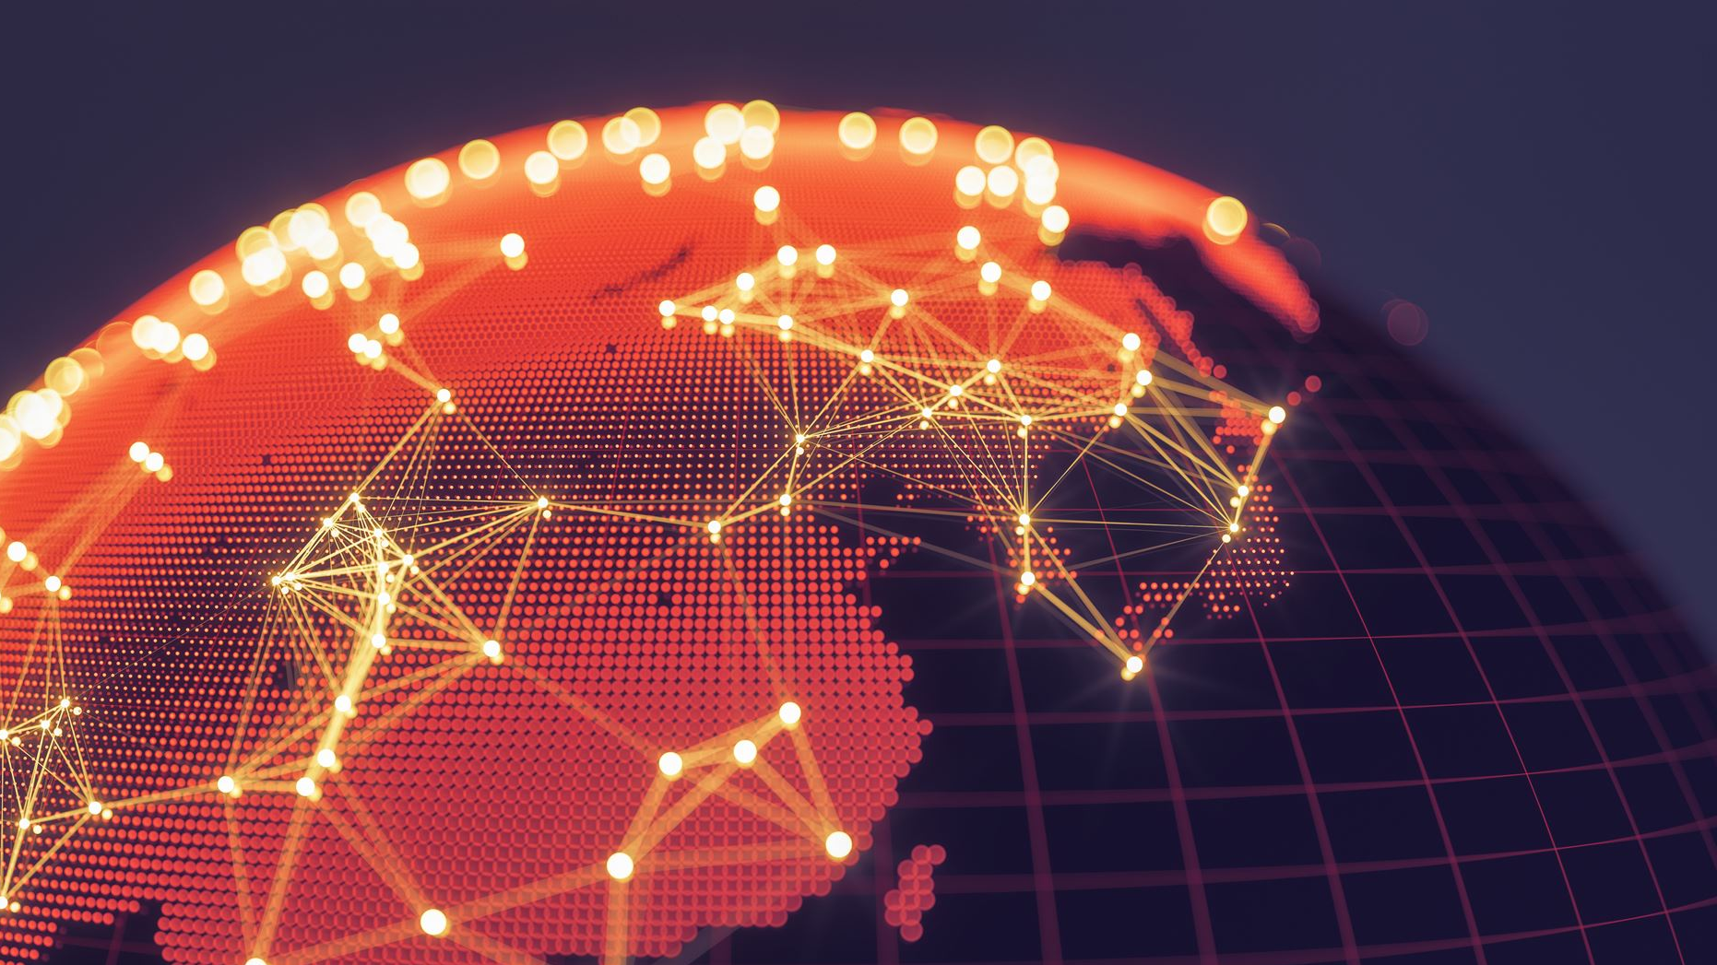
The Story of the Internet: From Concept to Global Network
Exploring the Internet's transformative journey
Notes:
AI-generated content may be incorrect. --- The Internet has transformed the way we communicate, work, and access information. In this presentation, we will explore the journey of the Internet from its early concepts to its current status as a global network, and discuss its profound impact on society.

Slide 2
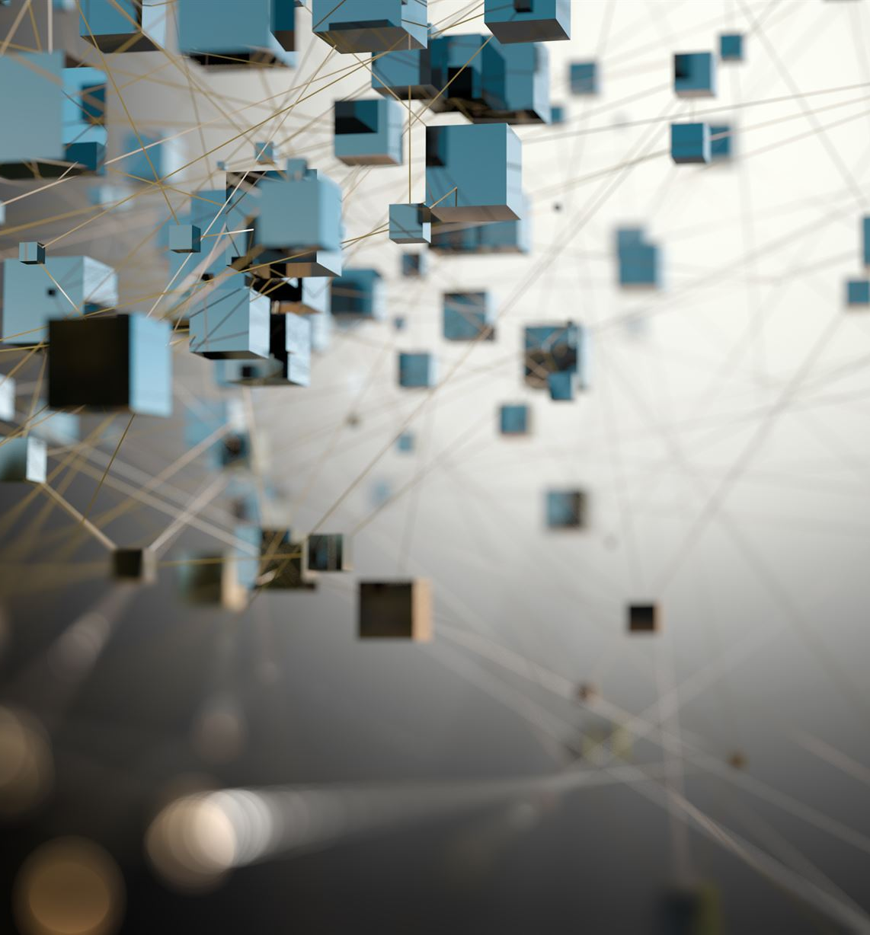
Agenda Items
The Origins of the Internet
Technical Foundations
Expansion and Commercialization
Impact on Society
Current Trends and Future Directions
Notes:
We will begin with the origins of the Internet, examining early concepts and the development of ARPANET. Next, we will discuss the technical foundations of the Internet that made it possible. We will then look at its expansion and commercialization, followed by its impact on society. Finally, we will explore current trends and future directions.

Slide 3
The Origins of the Internet
Notes:
The Internet’s story begins with visionary ideas about a global network that could connect people and share information. This section will discuss the early concepts and pioneering developments that laid the groundwork for what we know today.

Slide 4
Early Concepts of a Global Network
1960s Visionaries
Researchers in the 1960s imagined a global network enabling computers to communicate, paving the way for future technology.
Communication Over Distances
The concept involved systems that facilitated computer communication over long distances, integral to network evolution.
Foundation for Future Development
These early visions set the groundwork for the technological advancements that followed in networking and connectivity.
Notes:
The idea of a global network can be traced back to the 1960s. Researchers envisioned a system that would allow computers to communicate over vast distances, setting the stage for future developments.

Slide 5
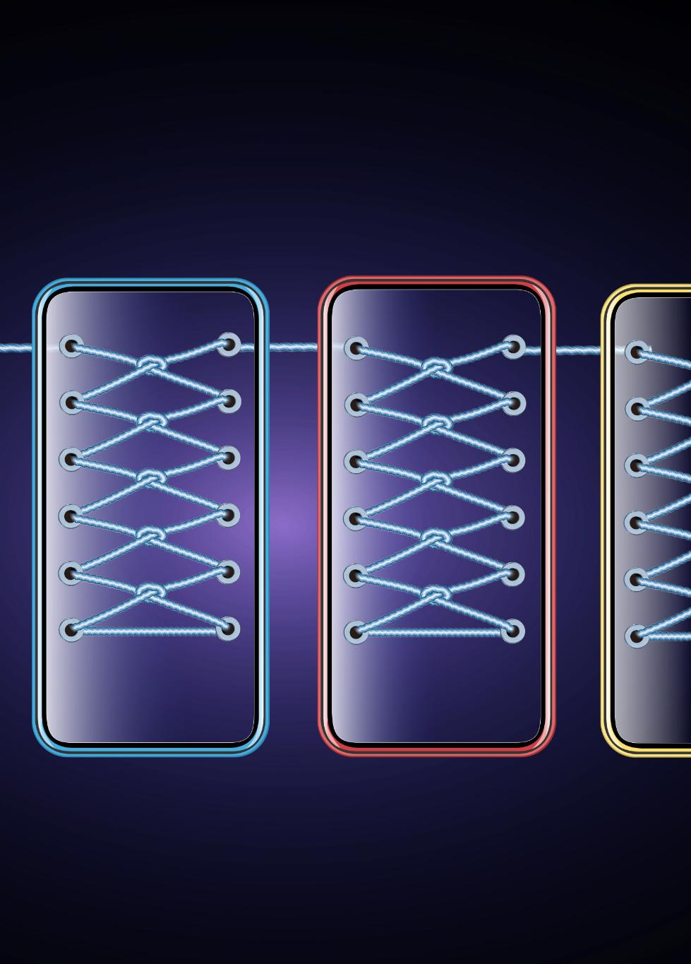
Development of ARPANET
Launch of ARPANET
ARPANET was launched in 1969 as the first network to utilize packet switching technology, revolutionizing data communication.
Packet Switching Technology
The implementation of packet switching allowed data to be shared efficiently across different locations, setting the stage for the Internet.
Connecting Nodes
ARPANET initially connected four nodes, showcasing the potential for interconnected networks and data sharing.
Notes:
ARPANET, launched in 1969, was the first network to implement packet switching and laid the foundation for the modern Internet. It connected four nodes and demonstrated how data could be shared across diverse locations.

Slide 6
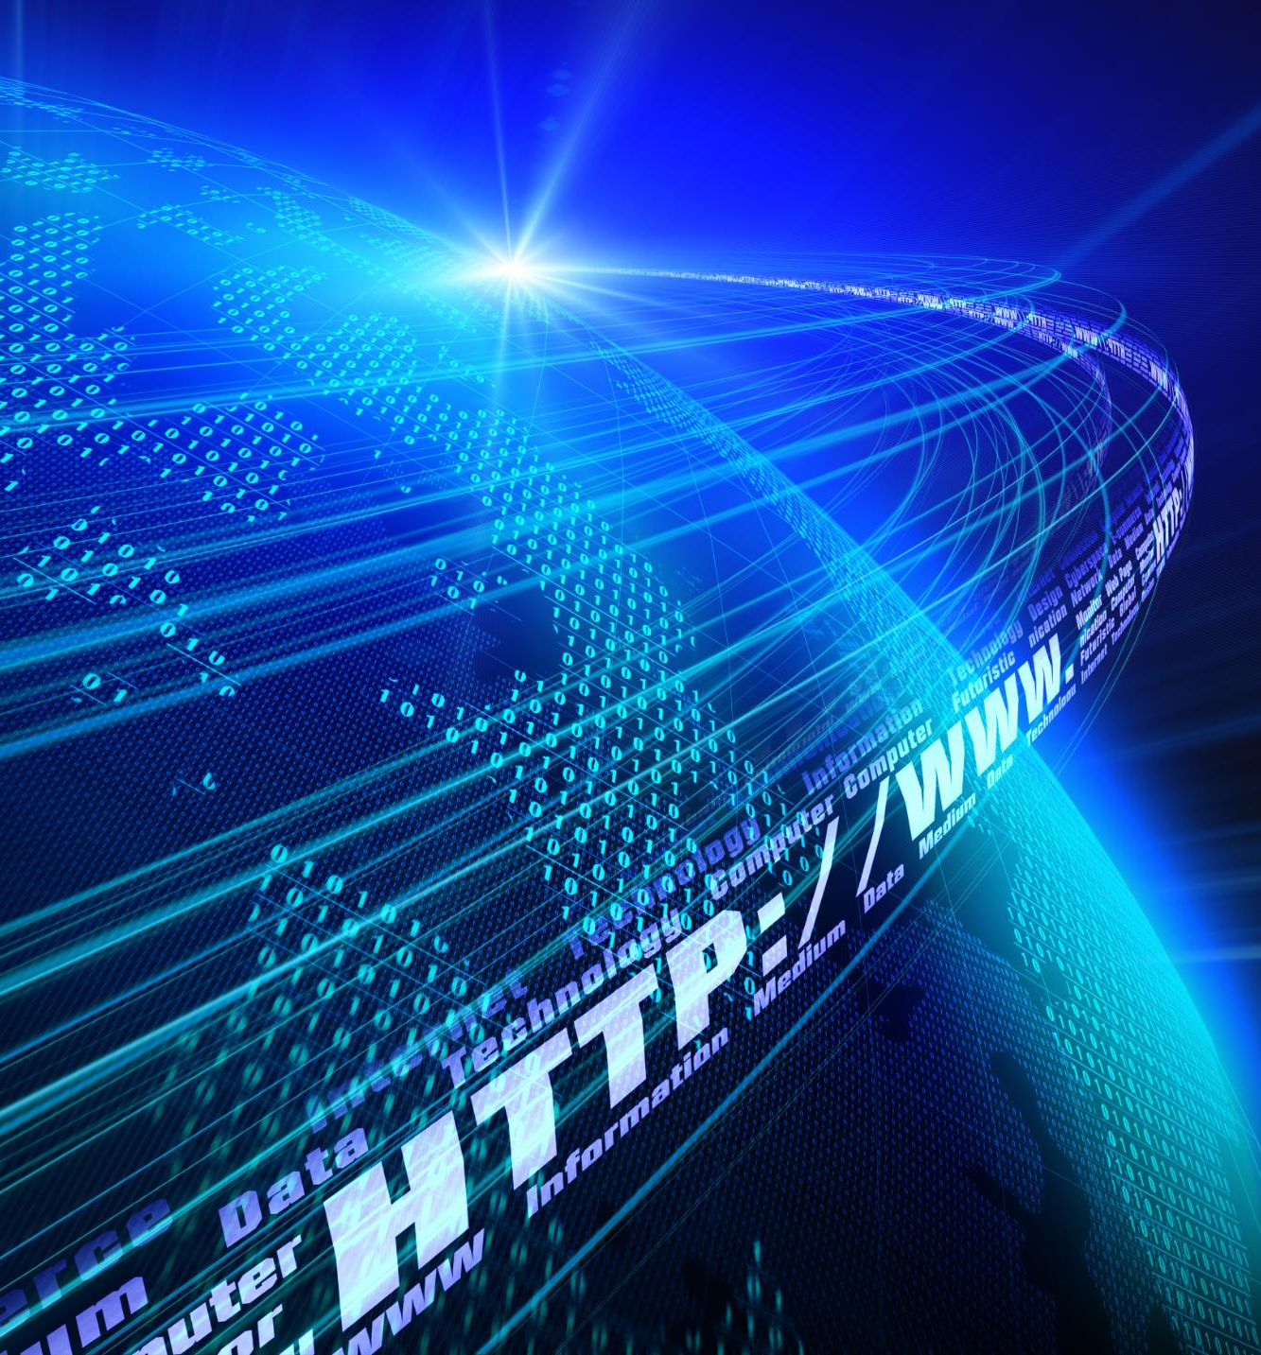
Key Figures and Pioneers
TCP/IP Protocols
The development of TCP/IP protocols was fundamental to the Internet's functionality and communication standards.
The World Wide Web
The invention of the World Wide Web revolutionized how information is shared and accessed globally.
Notes:
Several key figures played crucial roles in the development of the Internet, including Vint Cerf and Bob Kahn, who developed the TCP/IP protocols, and Tim Berners-Lee, who invented the World Wide Web.

Slide 7
Technical Foundations
Notes:
The Internet is built on several key technologies that enable data transmission and connectivity. This section will cover the essential technical components that form its backbone.

Slide 8
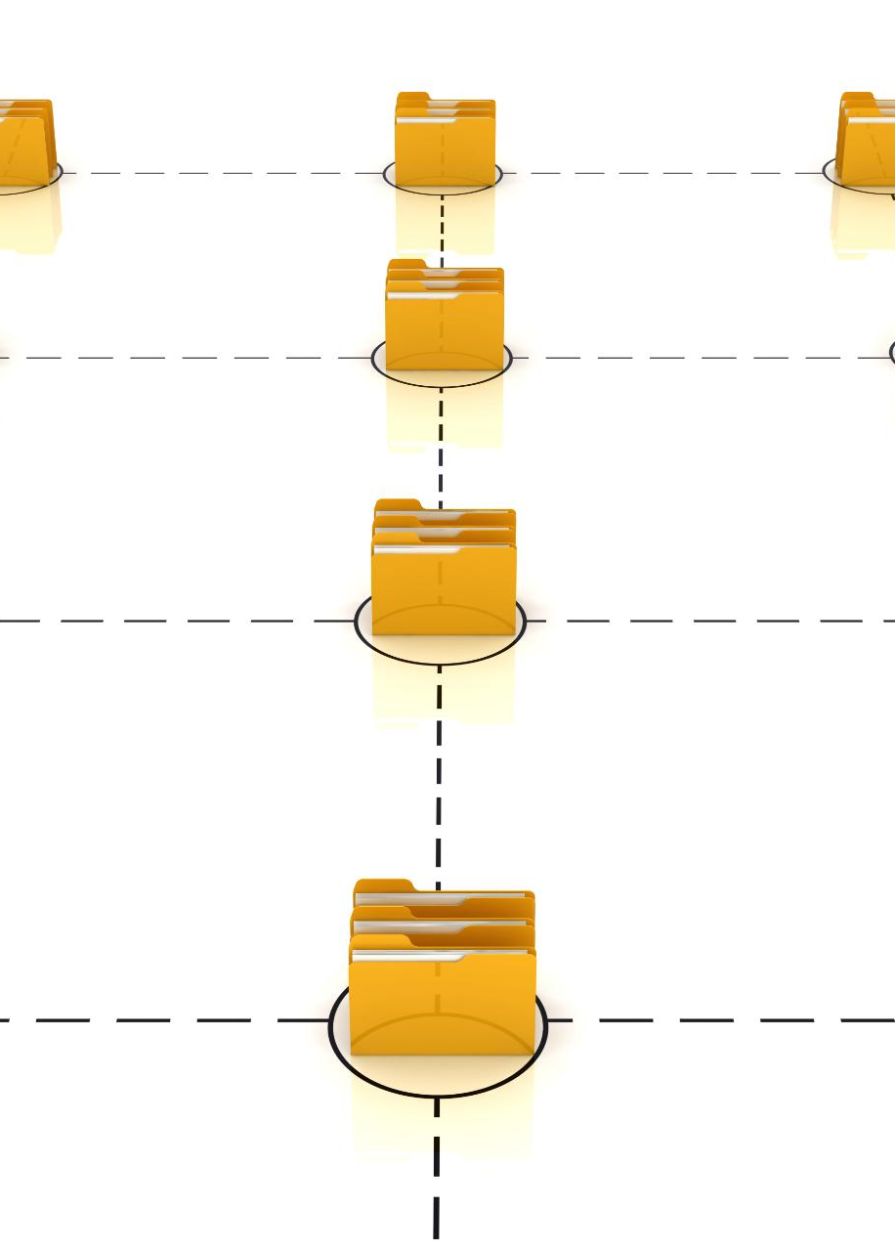
Packet Switching Technology
Data Transmission Method
Packet switching divides messages into smaller packets, allowing independent transmission across the network. This enhances communication efficiency.
Independent Packet Routing
Each packet can take a different route to reach its destination, optimizing network usage and reducing congestion.
Internet Communication
Packet switching is essential for efficient data communication over the Internet, enabling fast and reliable connections.
Notes:
Packet switching is a method of data transmission that divides messages into packets and sends them independently. This technology is crucial for efficient data communication over the Internet.

Slide 9

The Creation of TCP/IP Protocols
Standardization of Communication
The development of TCP/IP protocols standardized communication, enabling diverse systems to seamlessly connect and exchange information.
Foundation of Internet Communication
TCP/IP serves as the backbone of Internet communication, allowing different networks to collaborate effectively.
Notes:
TCP/IP protocols were developed to standardize communication across different networks, allowing diverse systems to connect and communicate. This framework is the foundation of Internet communication today.

Slide 10

Establishment of the Domain Name System (DNS)
User-Friendly Access
The DNS allows users to access websites using easy-to-remember domain names instead of complex numerical addresses.
Internet Accessibility
By simplifying web navigation, the DNS has contributed to making the Internet more accessible to everyone.
Foundation of the Internet
The creation of the DNS laid the groundwork for how we navigate and interact with the Internet today.
Notes:
The Domain Name System (DNS) was introduced to provide a user-friendly way to access websites using domain names instead of numerical IP addresses, making the Internet more accessible.

Slide 11
Expansion and Commercialization
Notes:
As the Internet evolved, it expanded beyond academic and military use to become a commercial and social platform. This section explores pivotal moments in the Internet's growth.

Slide 12
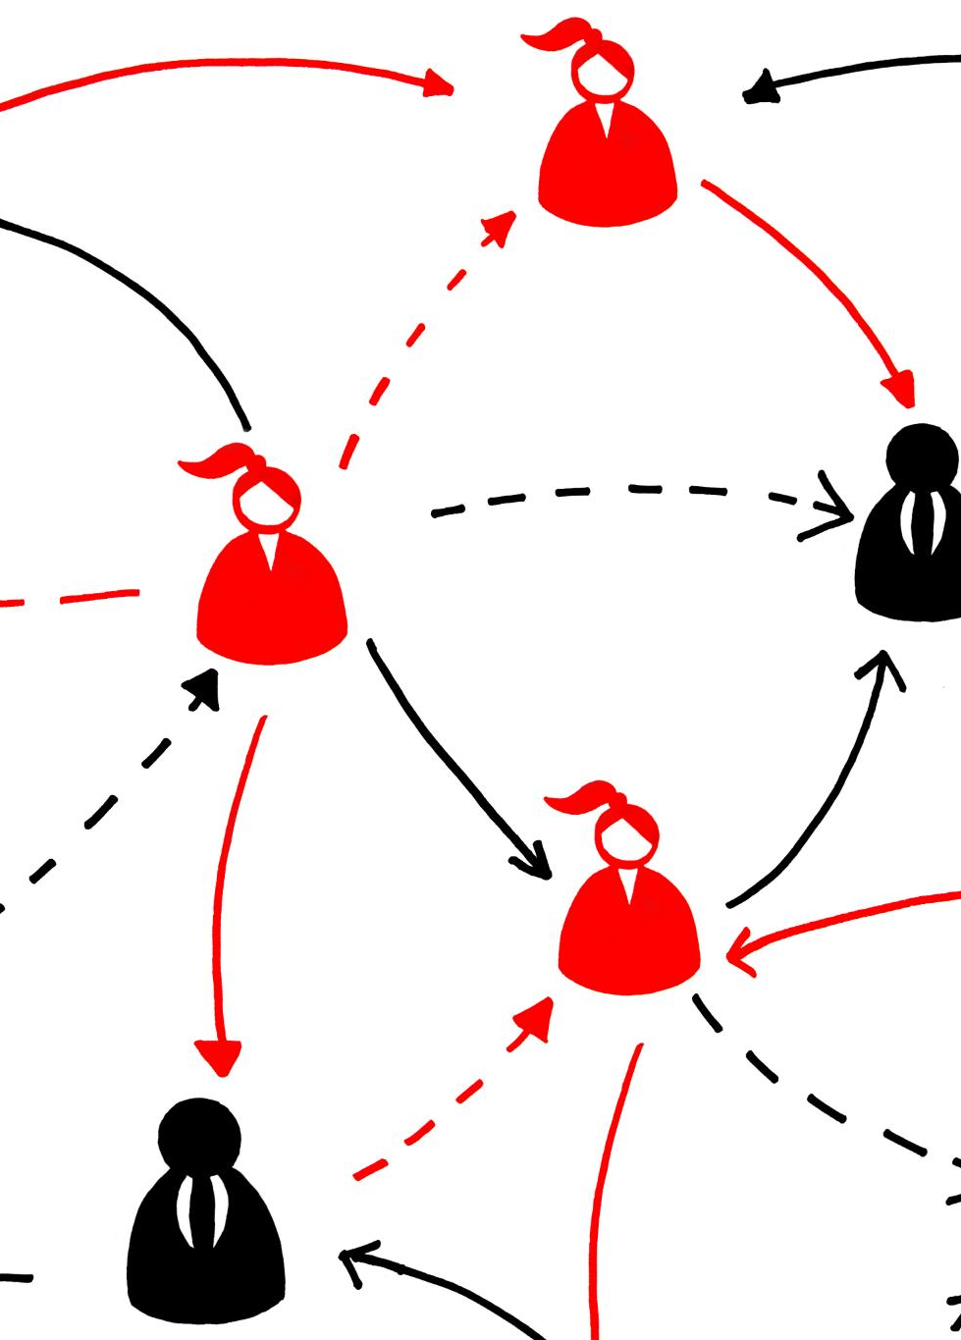
From ARPANET to the NSFNET
ARPANET Success
ARPANET was a pioneering project that set the stage for modern network communications, demonstrating the viability of packet switching.
Creation of NSFNET
The NSFNET, established in the 1980s, expanded network access and linked universities, significantly contributing to the Internet's growth.
Foundation of Modern Internet
The NSFNET served as a backbone for the evolving Internet, facilitating research and collaboration among institutions worldwide.
Notes:
After the success of ARPANET, the National Science Foundation Network (NSFNET) was created in the 1980s, which connected various universities and research institutions, paving the way for the modern Internet.

Slide 13
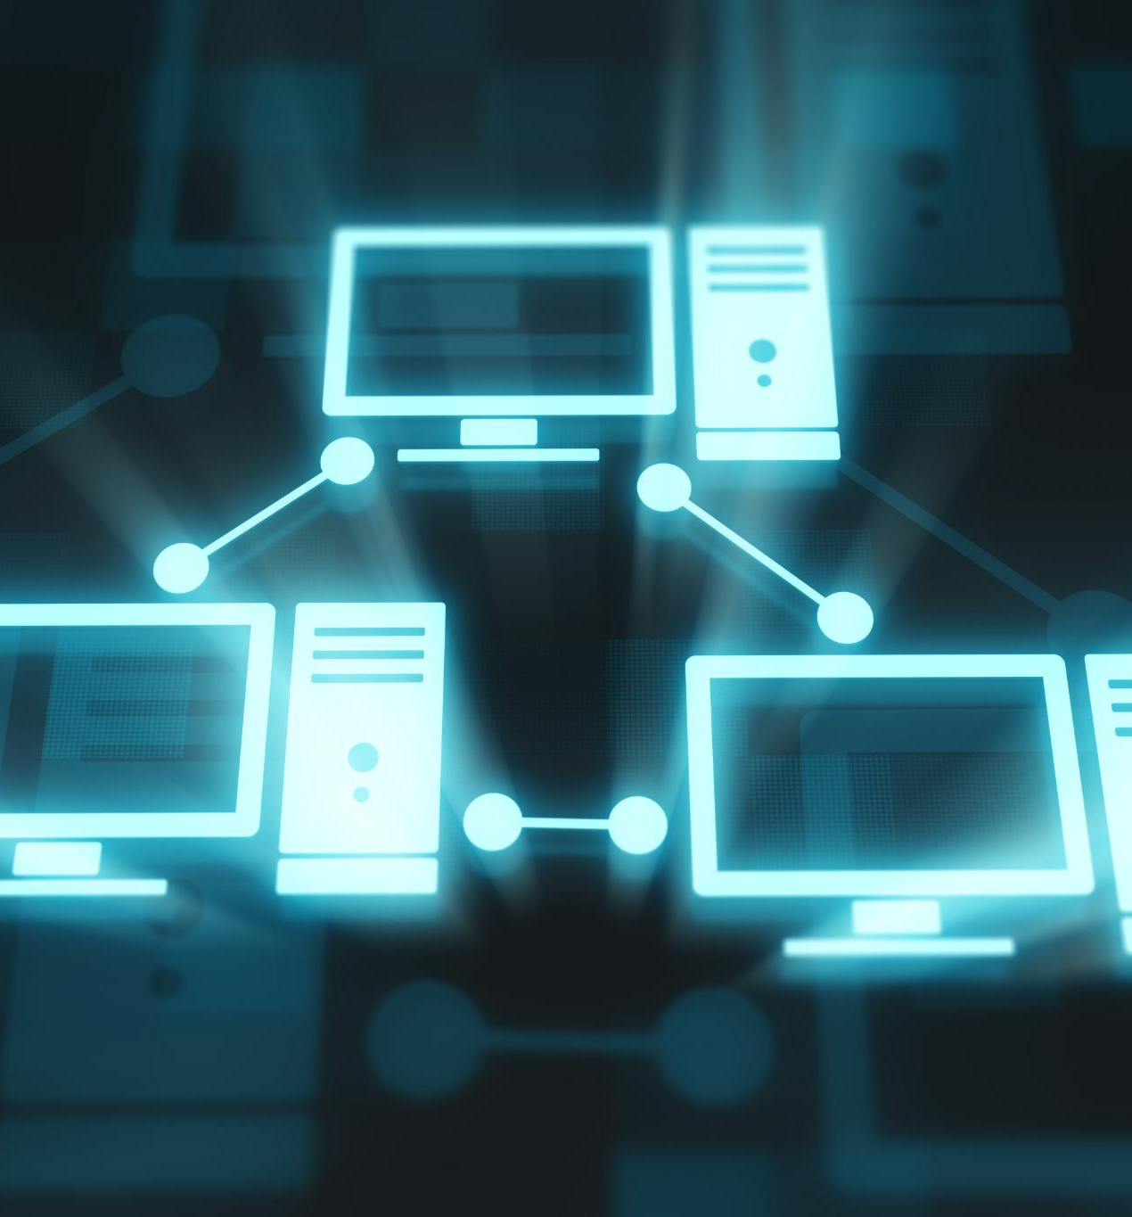
The Birth of the World Wide Web
Introduction of the Web
In 1991, Tim Berners-Lee introduced the World Wide Web, changing the landscape of information sharing forever.
Transformation of the Internet
This innovation turned the Internet from a technical tool into a user-friendly platform accessible to everyone.
Notes:
In 1991, Tim Berners-Lee introduced the World Wide Web, revolutionizing how information is shared and accessed. This innovation transformed the Internet into a user-friendly platform for everyone.

Slide 14
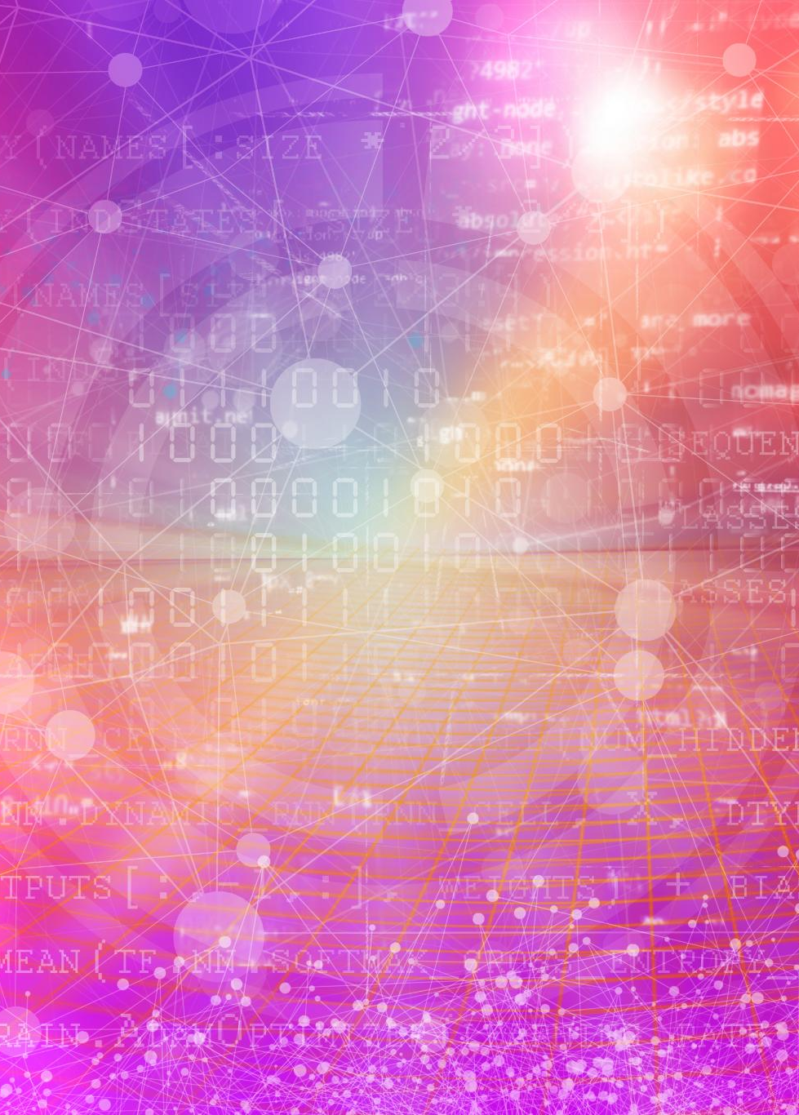
Commercialization and the Dot-Com Boom
The Rise of the Internet
The commercialization of the Internet in the late 1990s paved the way for new business opportunities and innovations.
Emergence of Dot-Com Companies
Numerous companies emerged during the dot-com boom, driving rapid innovation in various sectors of the economy.
Digital Economy Transformation
The dot-com boom significantly transformed the economy, creating a new digital landscape filled with e-commerce and online services.
Notes:
The late 1990s saw the commercialization of the Internet, leading to the dot-com boom. Many companies emerged, driving innovation and creating a new digital economy.

Slide 15
Impact on Society
Notes:
The Internet has profoundly affected how society functions, influencing communication, commerce, and education. This section discusses some of the most significant changes brought about by the Internet.

Slide 16
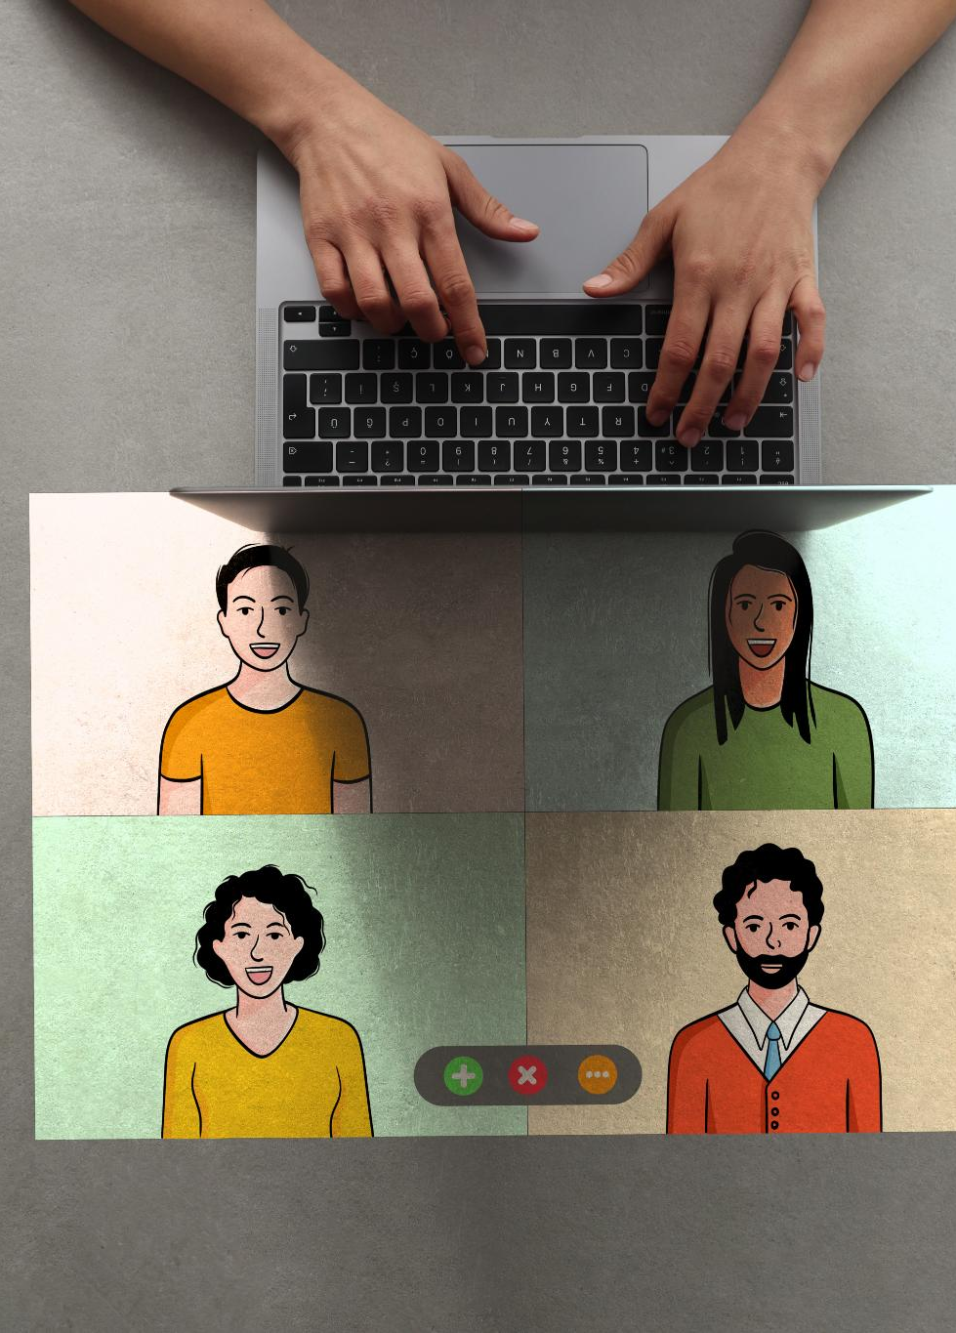
Transformation of Communication
Instant Messaging
Instant messaging has transformed how we communicate, enabling real-time conversations regardless of location.
Video Calls
Video calls have made it possible to have face-to-face interactions without being physically present, enhancing personal connections.
Social Media Connections
Social media platforms have created global networks, allowing people to connect and share experiences across distances.
Notes:
The Internet has revolutionized communication, allowing instant messaging, video calls, and social media interactions that connect people worldwide, breaking geographical barriers.

Slide 17
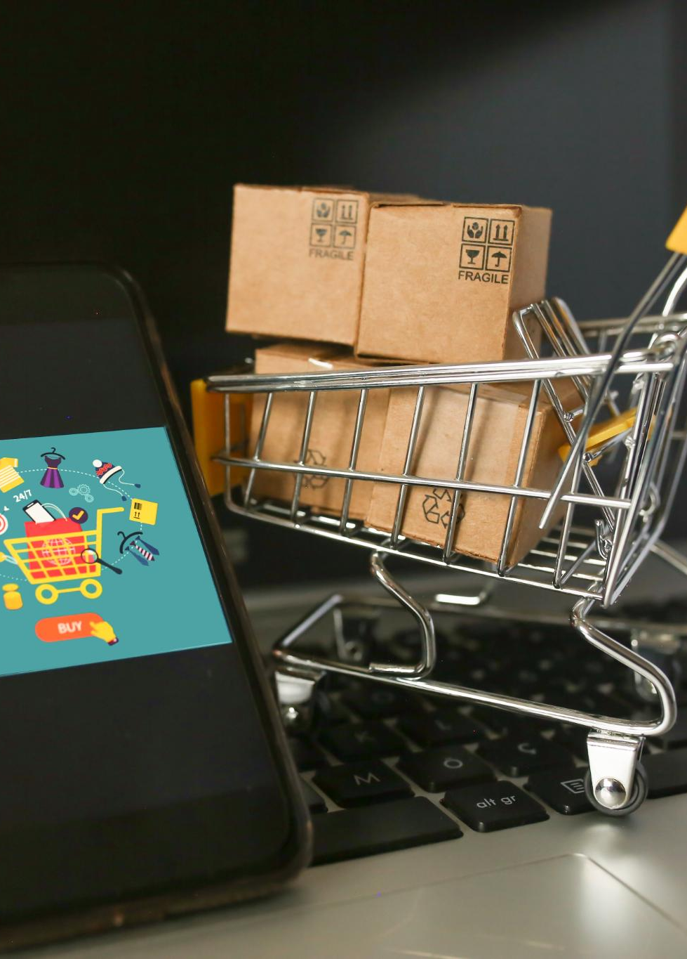
Changes in Industry and Commerce
E-Commerce Transformation
The rise of e-commerce has revolutionized the way businesses operate, allowing them to reach global audiences effortlessly.
Adaptation of Traditional Stores
Many traditional brick-and-mortar stores have adapted to the digital landscape by embracing online sales to survive and thrive.
Changing Consumer Behavior
Consumer behavior has shifted significantly, with more shoppers preferring the convenience of online purchasing over in-store visits.
Notes:
The rise of e-commerce has transformed industries, enabling businesses to reach customers globally. Traditional brick-and-mortar stores have embraced online sales, changing consumer behavior.

Slide 18

Influence on Education and Information Access
Democratization of Information
The Internet has made information accessible to everyone, breaking down barriers previously limiting education access.
Online Learning Resources
Numerous online platforms provide educational resources, allowing learners to study subjects at their own pace.
Global Education Opportunities
With online education, learners from different backgrounds can access quality education regardless of their location.
Notes:
The Internet has democratized access to information and education, providing online learning resources and platforms that enable global education opportunities for people of all ages.

Slide 19
Current Trends and Future Directions
Notes:
As the Internet continues to evolve, new trends and technologies are emerging. This section will examine current developments and speculate on future opportunities and challenges.

Slide 20
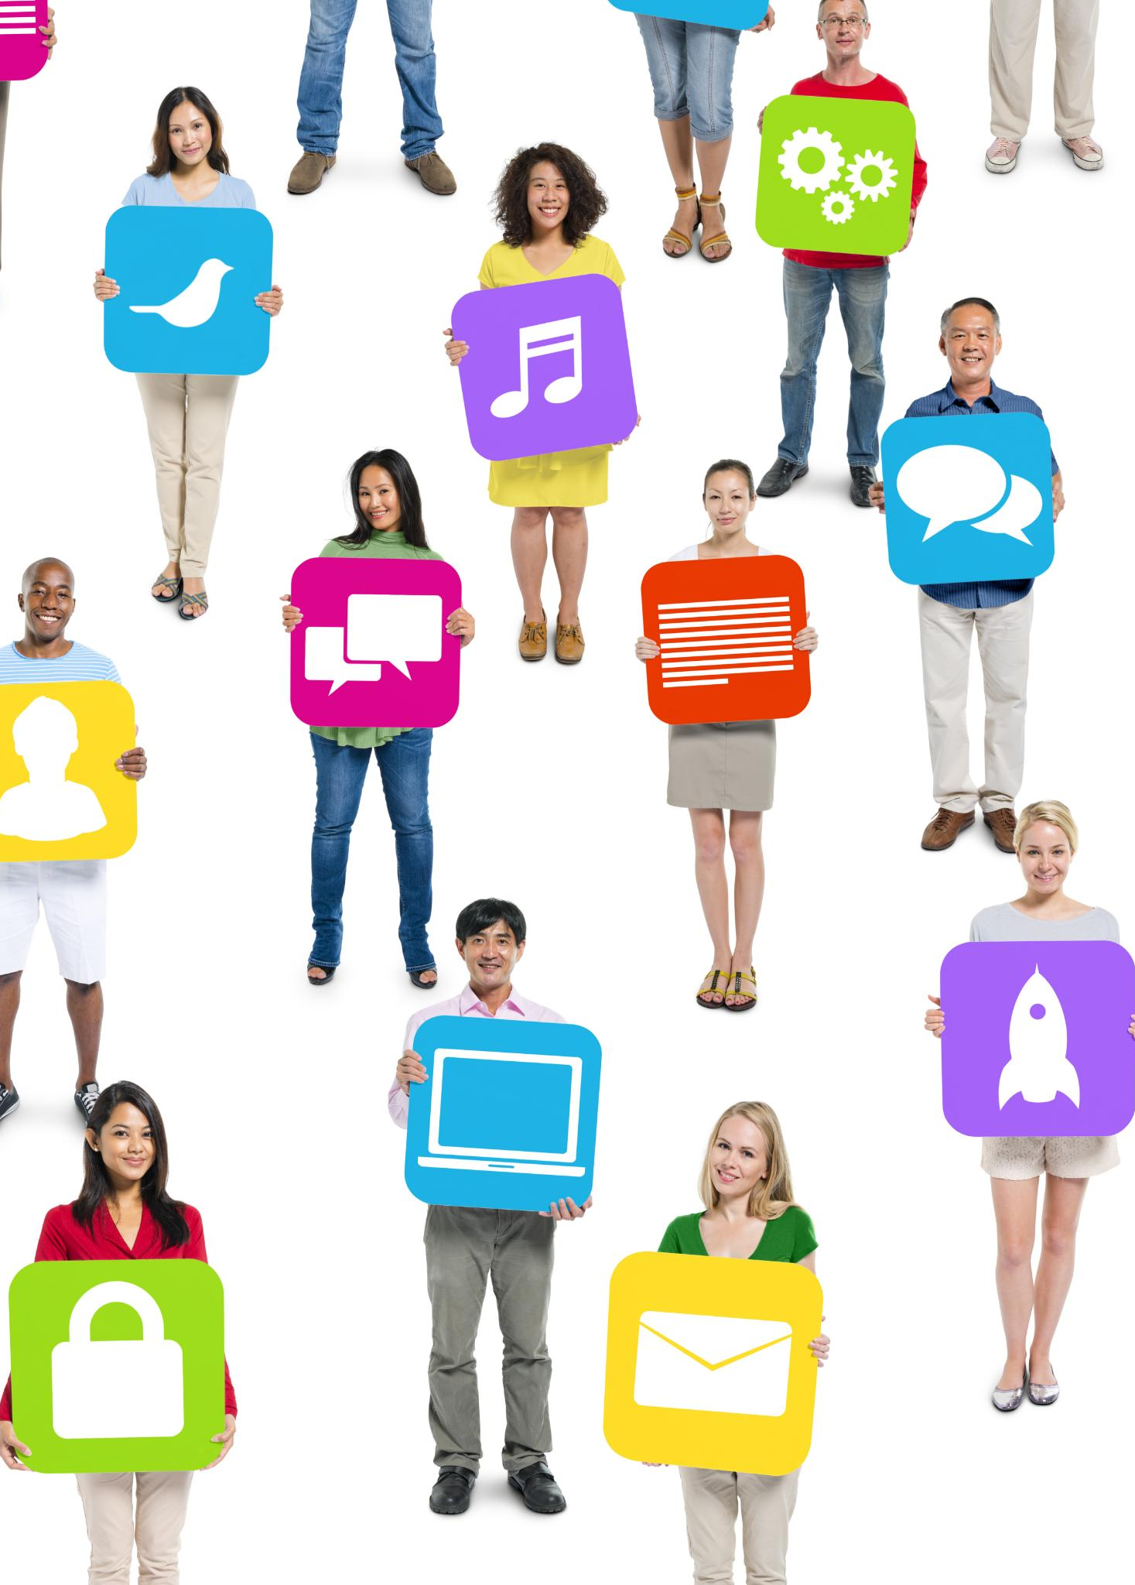
The Rise of Social Media and Digital Platforms
Changing Communication
Social media has transformed the way we communicate, allowing for instant sharing of thoughts and ideas across the globe.
Community Building
These platforms foster communities by connecting people with shared interests and enabling collaboration among users.
Marketing Evolution
Social media has created new avenues for marketing, allowing brands to reach their audiences more effectively and interactively.
Notes:
Social media platforms have changed how we interact and share information, fostering communities and creating new avenues for communication, marketing, and social interaction.

Slide 21
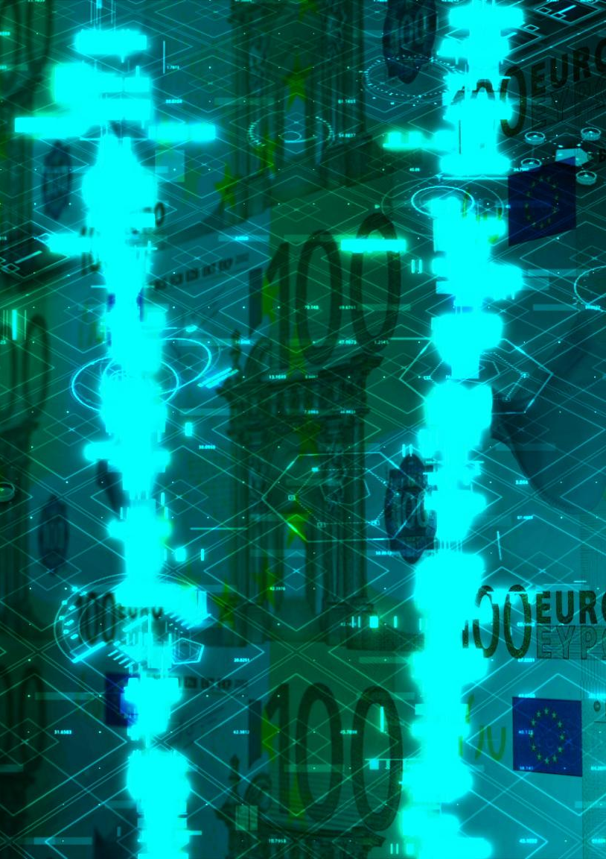
Emerging Technologies: IoT, AI, and Blockchain
Internet of Things (IoT)
IoT connects devices and systems, enabling data exchange and automation, revolutionizing how we interact with technology.
Artificial Intelligence (AI)
AI enhances decision-making and operational efficiency by processing large amounts of data, leading to smarter applications.
Blockchain Technology
Blockchain provides secure and transparent transactions, reshaping industries like finance, supply chain, and healthcare.
Notes:
The Internet of Things (IoT), Artificial Intelligence (AI), and blockchain technology are at the forefront of innovation, driving new applications and reshaping industries across the globe.

Slide 22
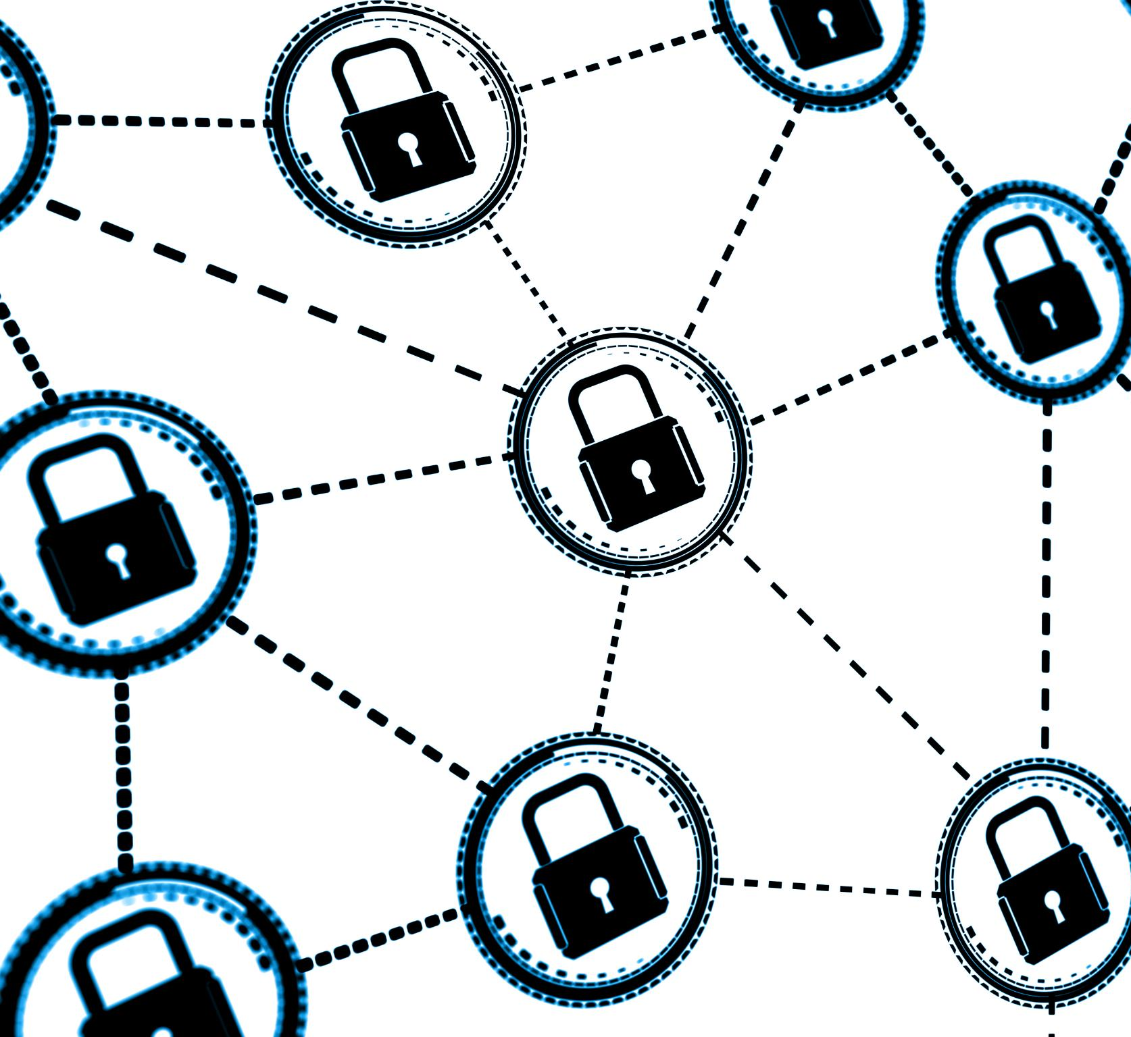
Future Challenges and Opportunities
Cybersecurity Threats
The growth of the Internet increases exposure to cybersecurity threats, necessitating stronger security measures and awareness.
Privacy Concerns
As online activities expand, privacy concerns become paramount, urging the need for better data protection regulations.
Digital Divide
The digital divide poses a challenge, highlighting inequalities in access to technology and the Internet across different populations.
Opportunities for Innovation
Despite challenges, the Internet fosters opportunities for innovation, enabling positive changes in various sectors.
Notes:
As the Internet grows, it faces challenges such as cybersecurity threats, privacy concerns, and the digital divide. However, it also presents opportunities for innovation and positive change.

Slide 23
Conclusion
Journey of the Internet
The Internet has evolved from a simple concept to a complex global network impacting millions of lives.
Societal Impact
The Internet has profoundly changed how we communicate, work, and access information, shaping modern society.
Future Challenges
Looking ahead, we must address challenges such as privacy, security, and misinformation in the digital landscape.
Harnessing Potential
We should focus on leveraging the Internet's potential for positive change and innovation in society.
Notes:
The Internet's journey from a concept to a global network is remarkable. Its impact on society is profound, and as we look to the future, we must navigate its challenges and harness its potential for good.

